Slide 1
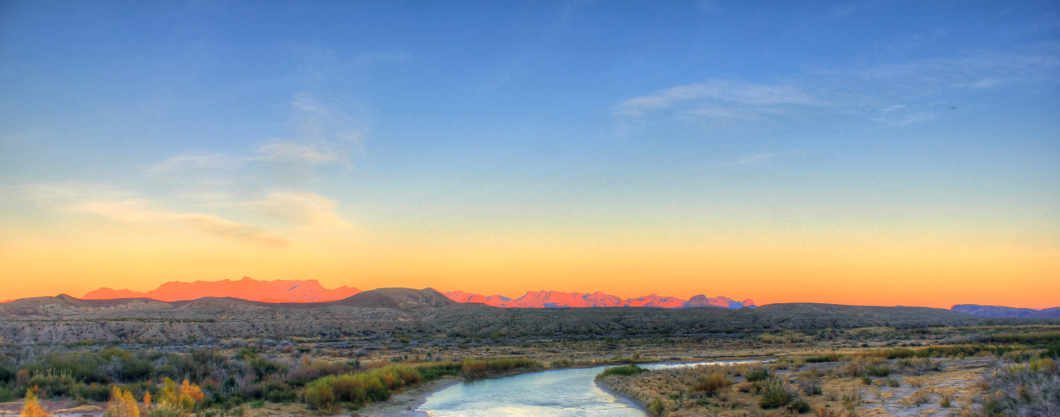

Get Outside Alliance
Web app dashboard --Team 2
Sami Eldaw
Charaf Lachouri
Kevin Maldonado
Tatiana Uklist
Tanner Waggoneer

Slide 2
TABLE OF CONTENTS
01
02
03
04
Objectives and Mission Statement
Project Origin and Our Client
Dashboard Design and Demo
User Manual and Key Takeaways

Slide 3
01.
Project Origin/ Our Client

Slide 4
Project Origin
Brainstorming through different ideas led us to our common goal of utilizing our combined knowledge and skills of data analytics for a project
A proposal for working with a non-profit was proposed by Tatiana

Slide 5
Our Client
Established in 2021, our client's mission is to inspire and empower individuals to engage with their local state parks and natural environments through volunteerism

Slide 6
02.
Objectives/ Mission Statement

Slide 7
Objectives
Create a dashboard that can be used as a tool to show demographic data for counties containing State Parks
Create a user manual for the dashboard/tool created

Slide 8
Mission Statement
The project team’s mission is to develop a resource for the Get Outside Alliance team to scale their outreach and eventually scale their volunteer participation so that the team can focus their efforts on creating more volunteer opportunities with the Texas State Park System

Slide 9
03.
Dashboard Design/ Demo

Slide 10
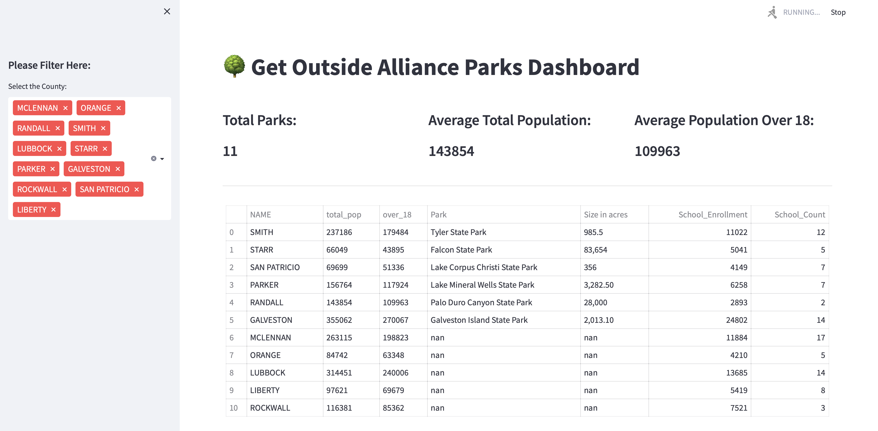

Dashboard Design
01
Title
02
Filter
03
Stats
04
Data Table

Slide 11
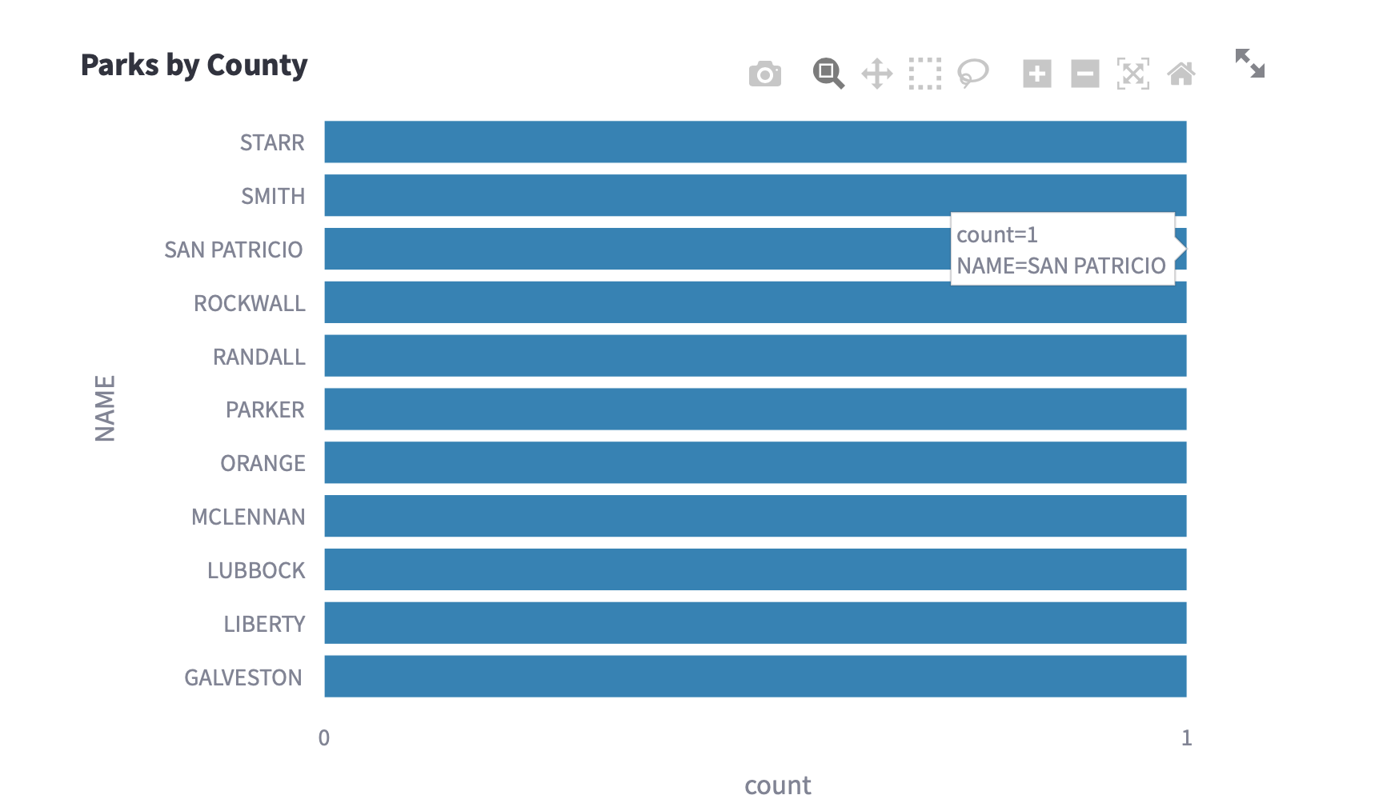
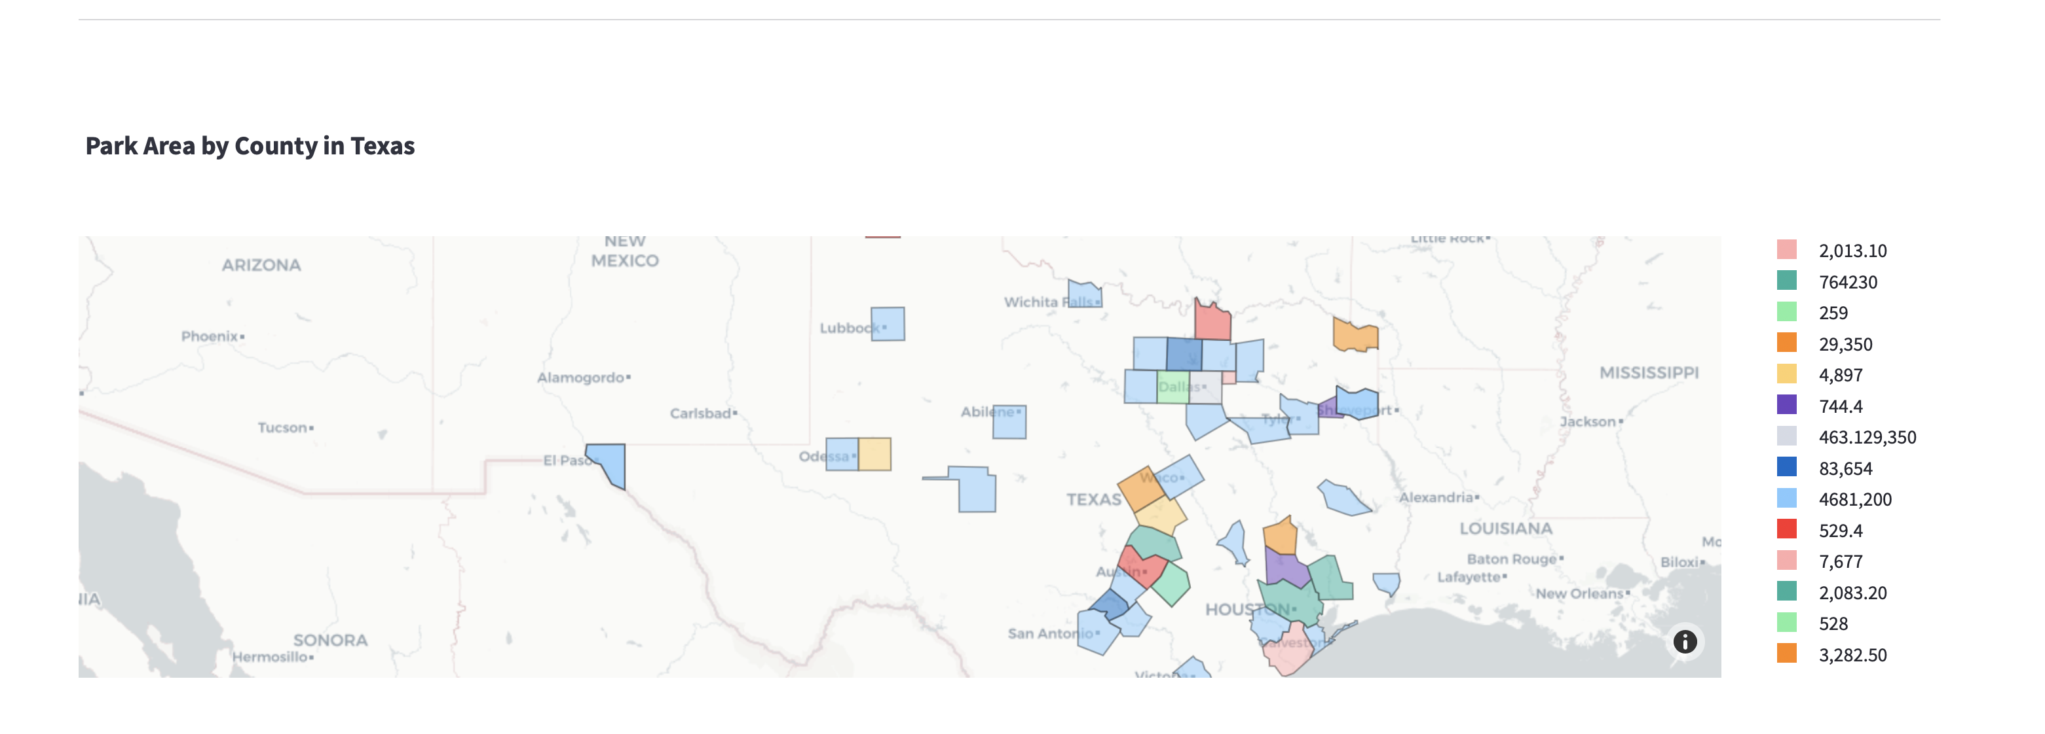
Dashboard Design

Slide 12
DEMO

Slide 13
04.
User Manual/ Key Takeaways

Slide 14
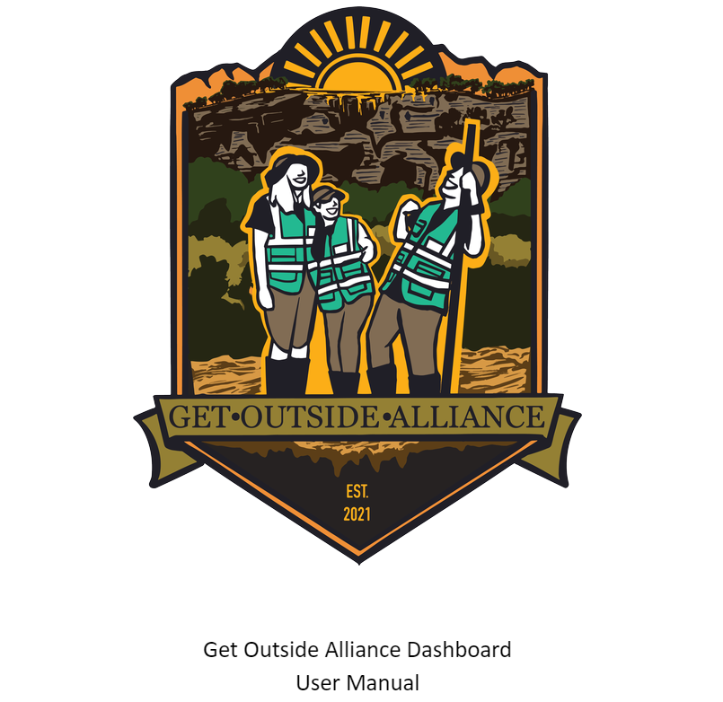
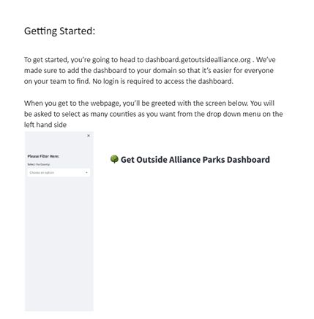
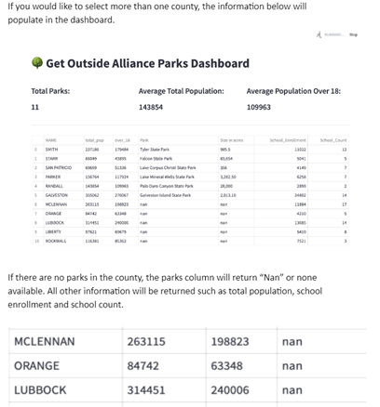
User Manual

Slide 15
Key Takeaways
Having an easy and communicative client helped with the overall implementation. Had we had to find another client, it probably wouldn't have moved as smoothly as it did
It took a couple sessions but working in a "sprint" mindset over a "marathon" mindset helped our team with such a technical project
Although our project focus shift was small, it was a good reminder that shifts and changes are sometimes necessary and it's very important to have the change control system in place

Slide 16

THANKS
Do you have any questions?

